Slide 1
QOVIS User Study Tutorial

Slide 2
Contents
Background
Query Optimization Issues
Analysis Methods
The log
QOVIS system
User Study Guideline
Cheating Sheet

Slide 3
Background*
One query optimization process consists of multiple steps
Each step convert one plan to another
Analysis
Optimization
Planning
AQE #1
AQE #2
Unresolved logical plan
Analyzed logical plan
Optimized logical plan
Physical plan
AQE plan
AQE plan #2
SQL query
Catalog
Execute
Statistics data
Operator Optimization
…
Plan #0
Plan #2
Plan #N
High-level step
Plan
Data
Step hierarchy
Low-level step
Plan #0
Column Pruning
Plan #1
Predicate Pushdown
Plan #2
Step
Data flow
* Use Spark 3.3.0 as an example

Slide 4
Query Optimization Issues
Root cause step
Transformation issue
Produces a non-equivalent plan in one step
E.g., wrong predicate rewriting
Workflow issue
Results in useless steps or loops that waste time
E.g., loop optimization
Step1
Step2
Step3
Plan0
Plan1
Plan2
Plan3
Non-equivalent
Root cause steps
Step1
Step2
Step3
…
Step5
Plan0
Plan1
Plan0
Plan1
Plan0
Plan1
Plan loop

Slide 5
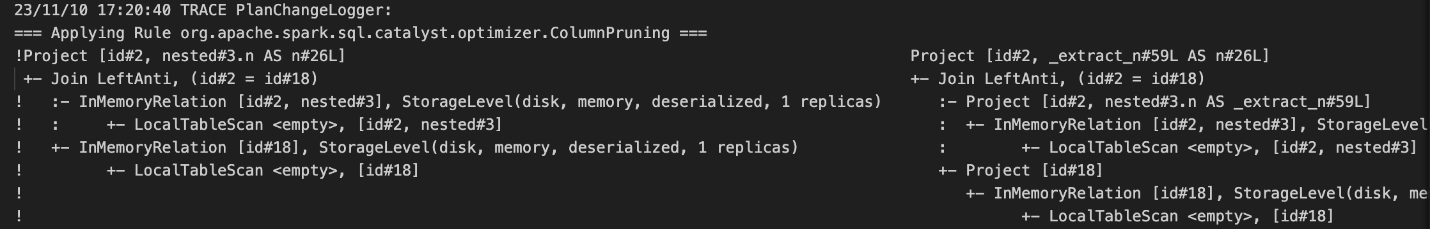


Analysis Method: Logs
The column type can be a struct
SELECT id, nested.n
FROM A LEFT ANTI JOIN B
The logs (the most traditional method)
Step name
Plan before transformation
Plan after transformation
Diff row marks
Project
Expressions
Join LeftAnti
Join conditions
InMemoryRelation
InMemoryRelation
Attribute object id
LocalTableScan
Attribute name
LocalTableScan

Slide 6

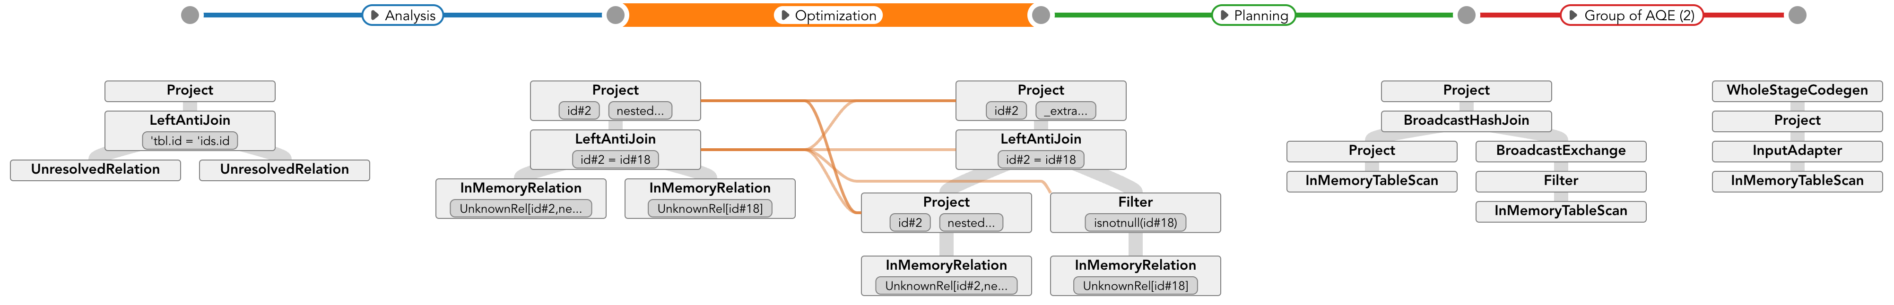
Analysis Method: QOVIS
Step name
or Group of
Step name
with
repeat #
The height encodes
Total step #
Navigation view
Plan view
Analysis
Optimization
Planning
AQE #1
AQE #2
Unresolved logical plan
Analyzed logical plan
Optimized logical plan
Physical plan
AQE plan
AQE plan #2
SQL query
Catalog
Execute
Statistics data

Slide 7
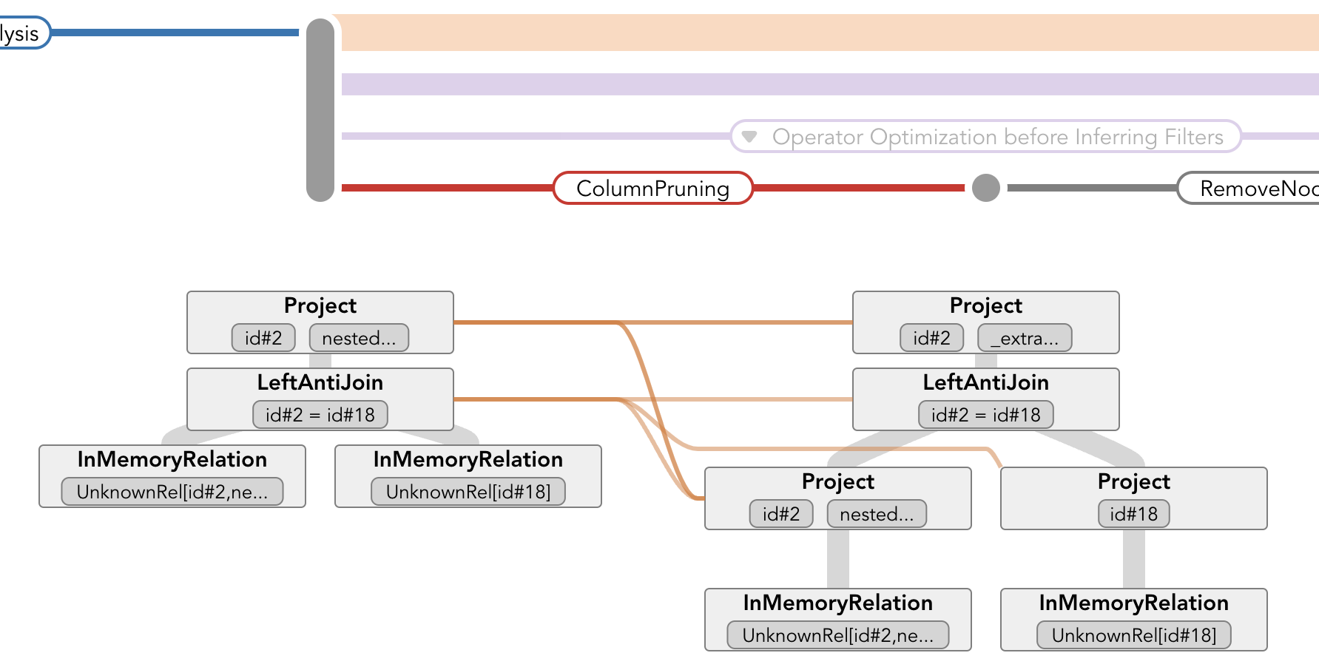
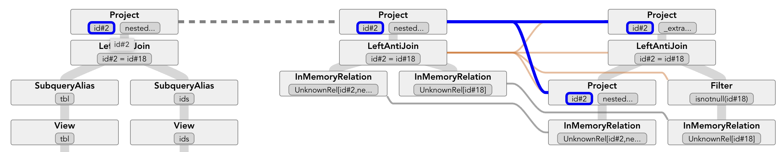
Analysis Method: QOVIS
Step hierarchy
Step name
Plan before transformation
Plan after transformation
Transformation linkages
Parameters are changed by this step
No transformation found, but they have the same type and value
Transformation found and they are not changed

Slide 8
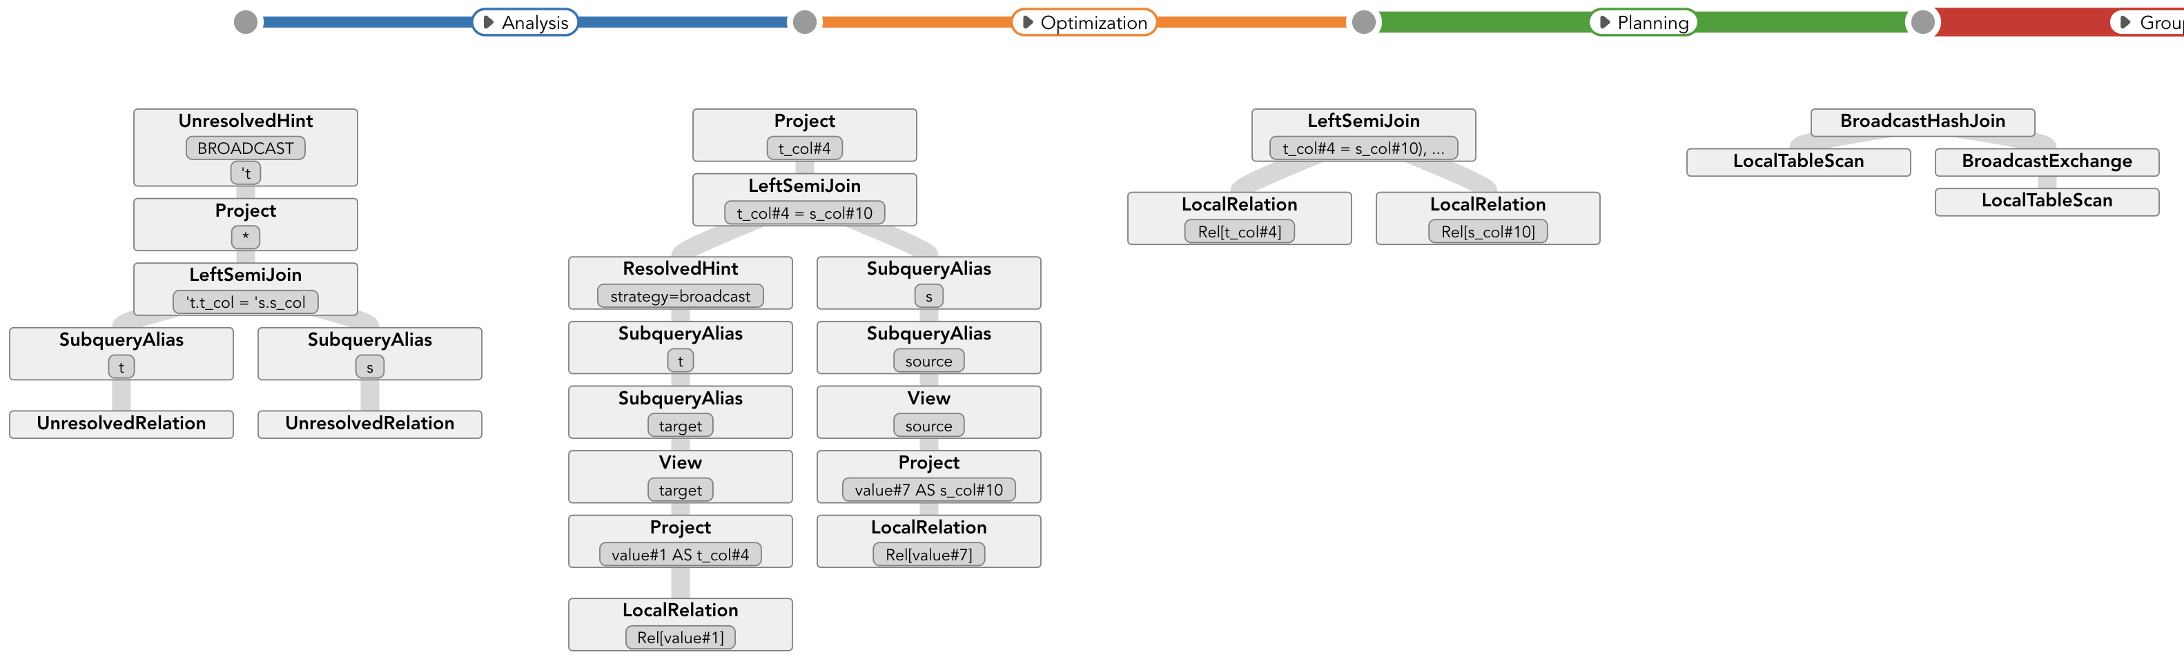
Example
* Left semi/anti join https://zhuanlan.zhihu.com/p/590074550
SELECT /*+ BROADCAST(t) */ * FROM target t LEFT SEMI JOIN source s on t.t_col = s.s_col
Analysis
Optimization
Planning
AQE #1
AQE #2
Unresolved logical plan
Analyzed logical plan
Optimized logical plan
Physical plan
AQE plan
AQE plan #2
SQL query
Catalog
Execute
Statistics data

Slide 9
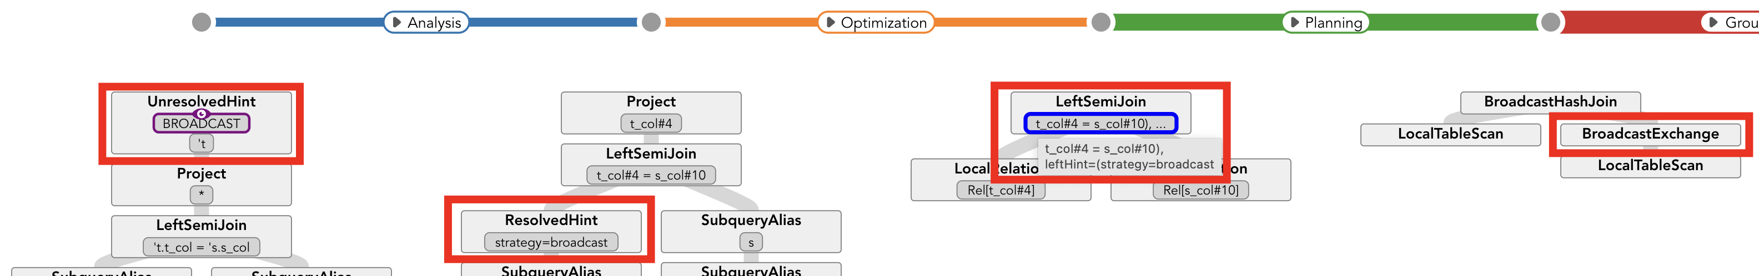
Example: Hint Process
* Left semi/anti join https://zhuanlan.zhihu.com/p/590074550
SELECT /*+ BROADCAST(t) */ * FROM target t LEFT SEMI JOIN source s on t.t_col = s.s_col
/*+ BROADCAST(t) */ means broadcast table t when join
The hint will process as follow:
As a single node ResolvedHint in the plan in Analysis phase
Be set to join node in Optimization phase
Convert to a BroadcastExchange node in Planning phase.

Slide 10
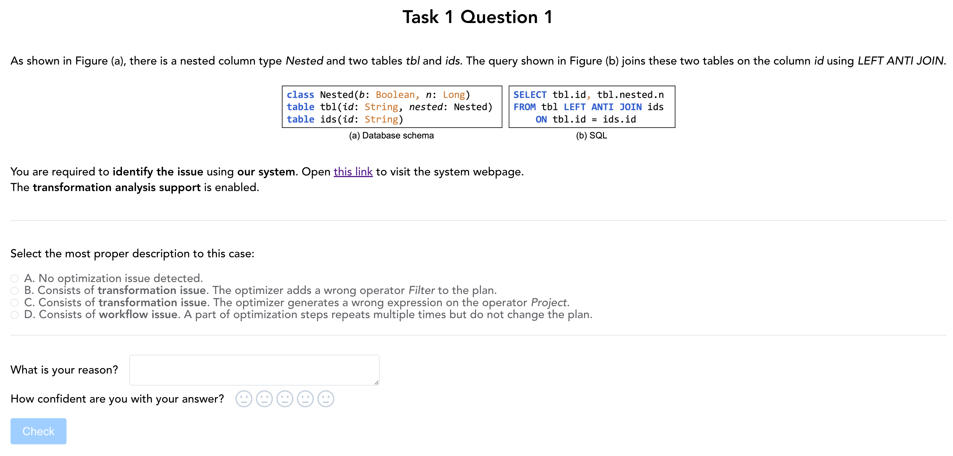
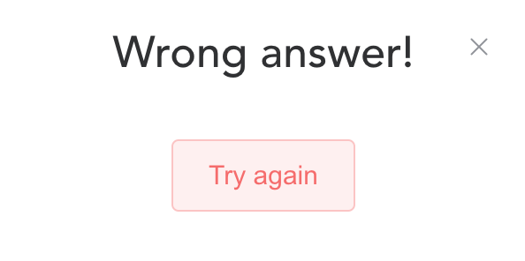
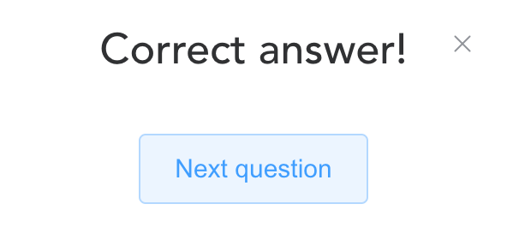
User Study Guideline
Task 1 (T1): identify whether there is an issue. 6 questions
Task 2 (T2): locate the root cause (one or several steps). 3 questions
In each question, you will attempt to find the correct answer of an MCQ (multiple choose question) .
You are required to:
Select an option
Explain your reason
Set your confident level
Until you find the right answer

Slide 11
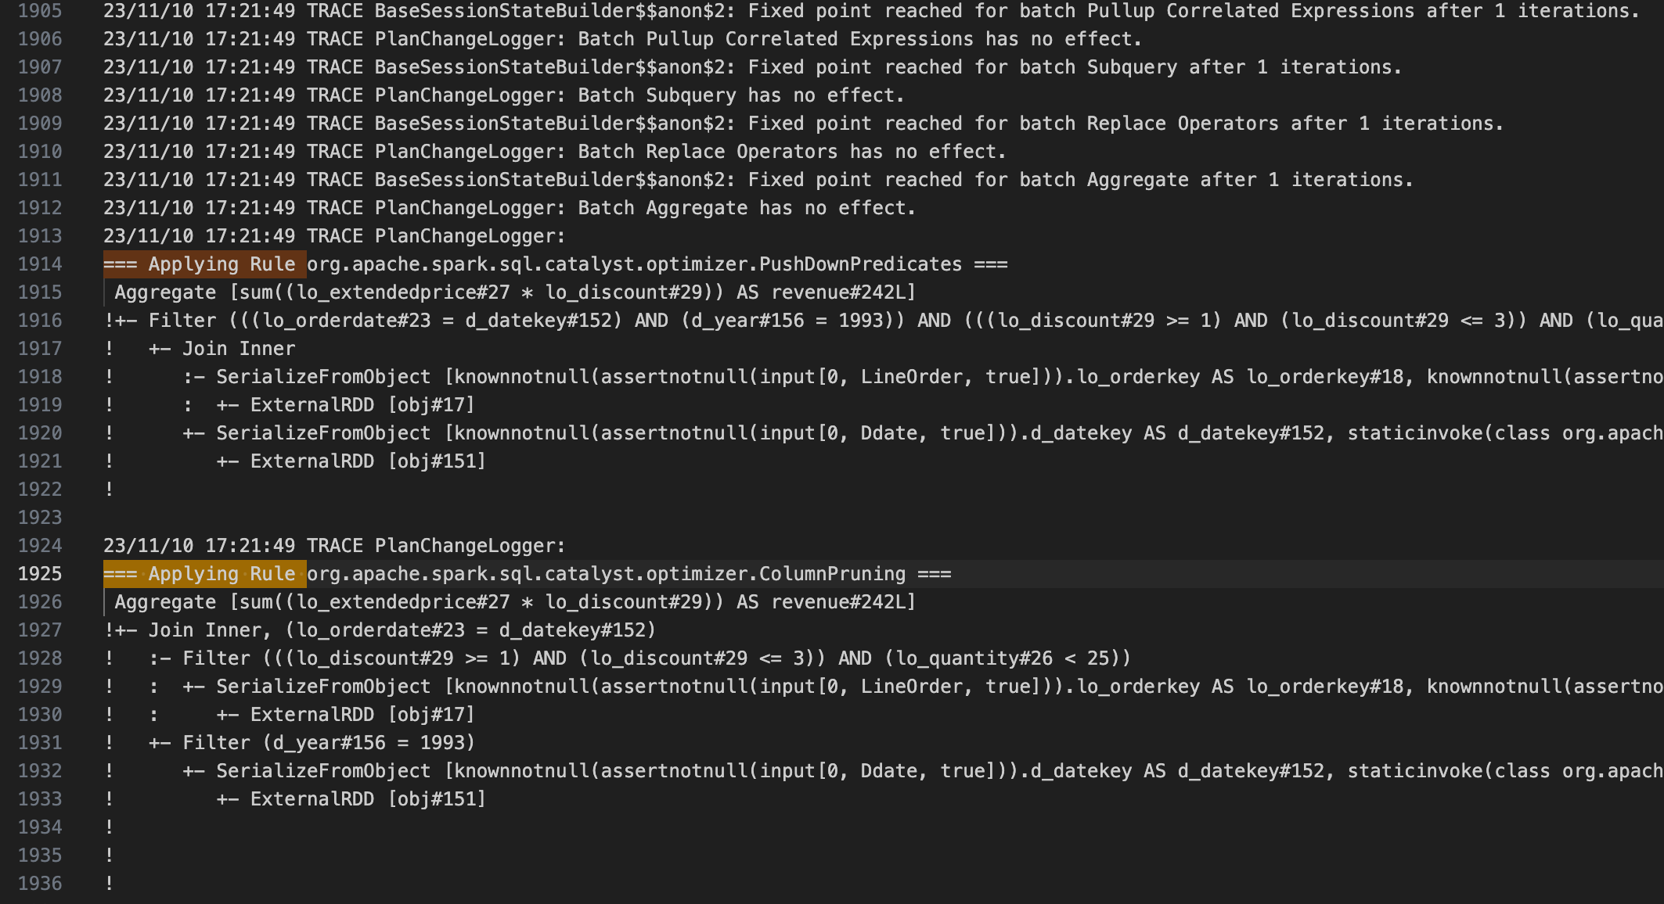
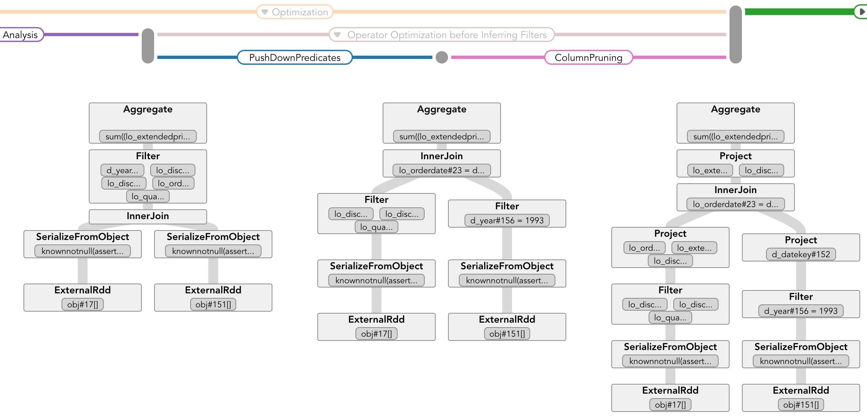
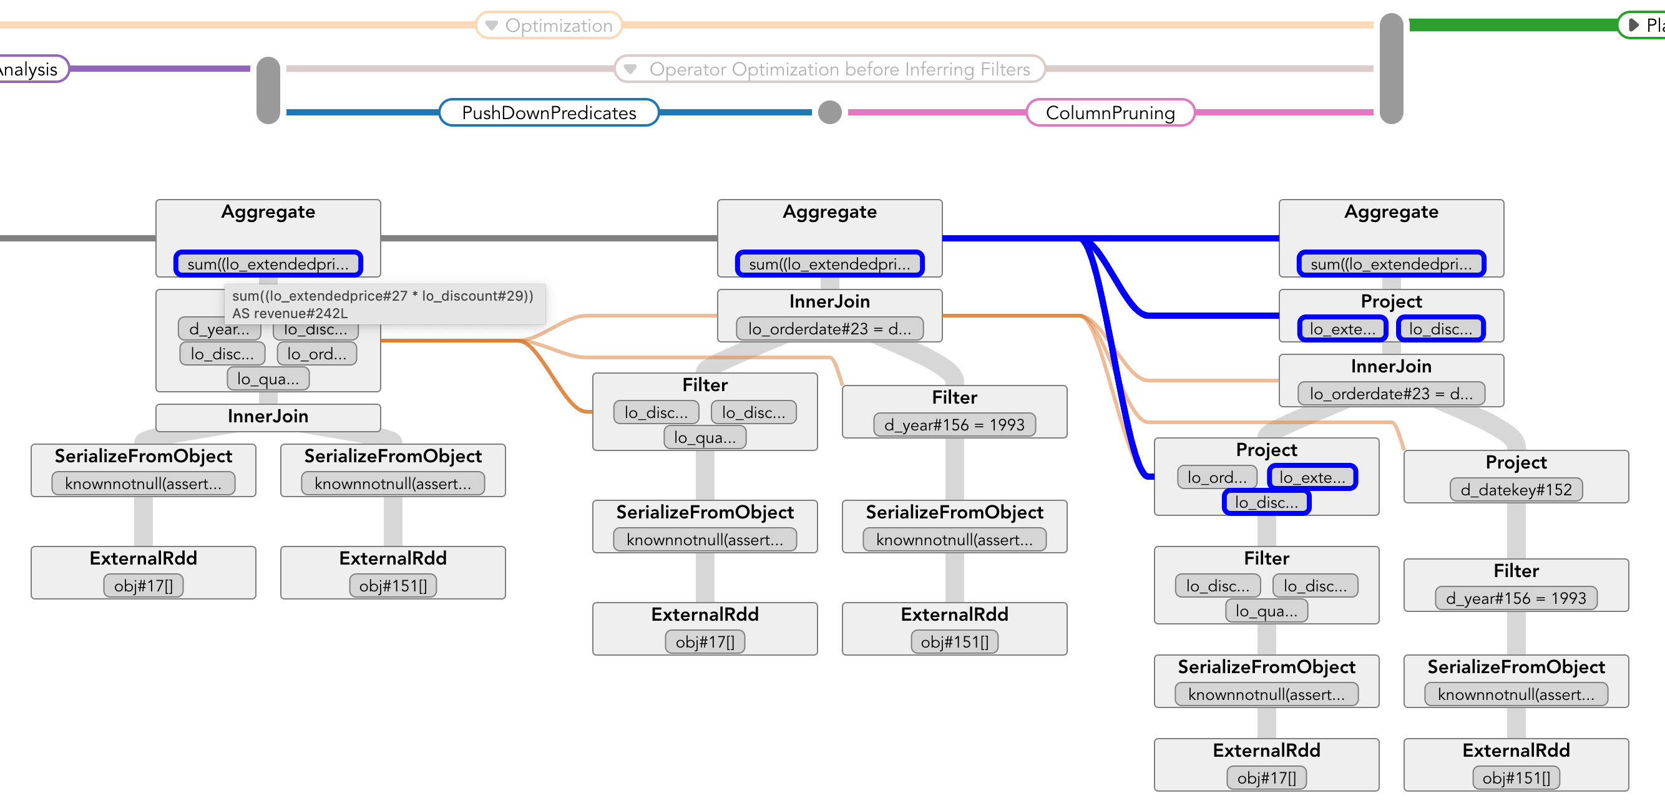
User Study Guideline
You will be assigned to 3 different analysis methods:
Your time usage and error will be recorded
Log files
QOVIS without
transformation analysis support
QOVIS

Slide 12
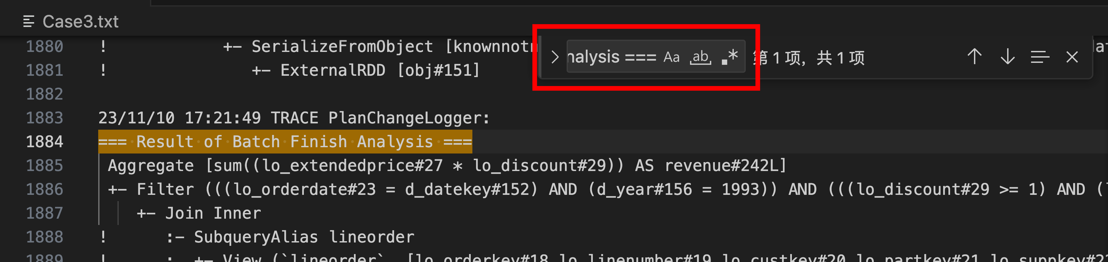
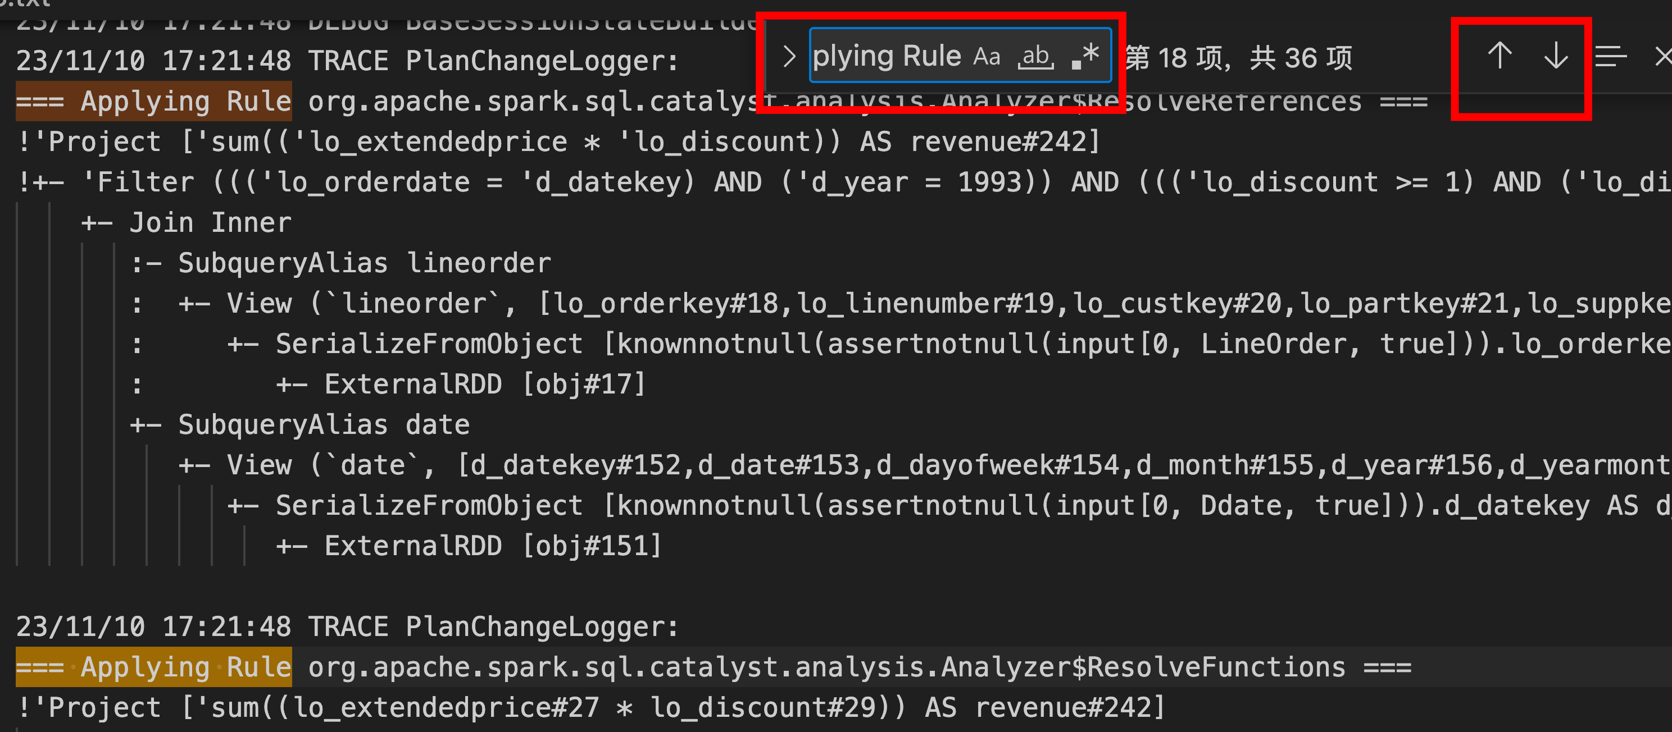
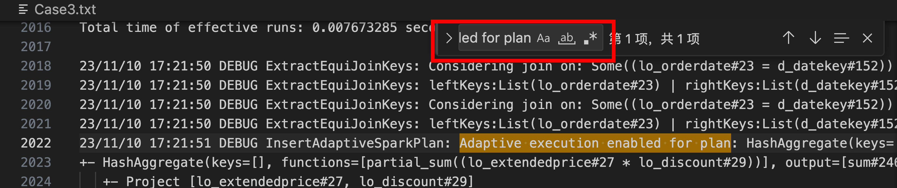
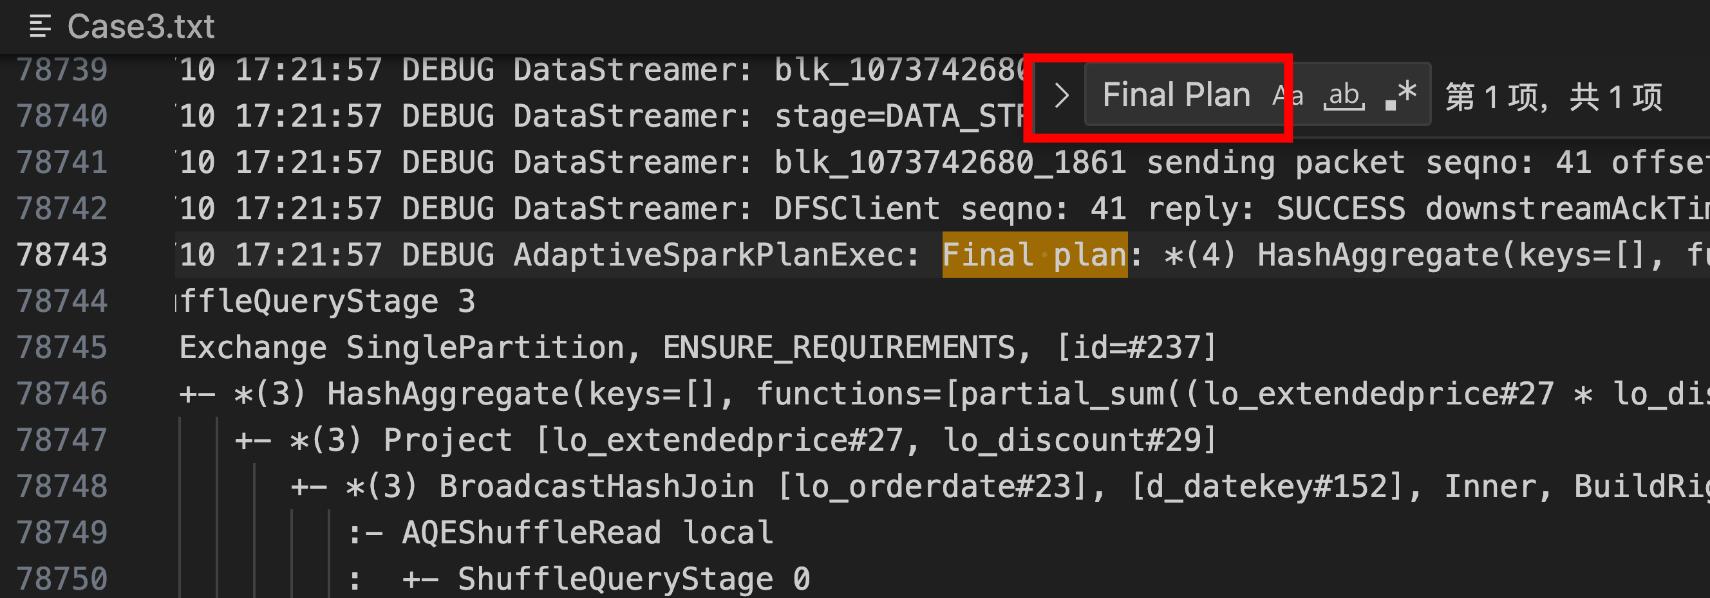
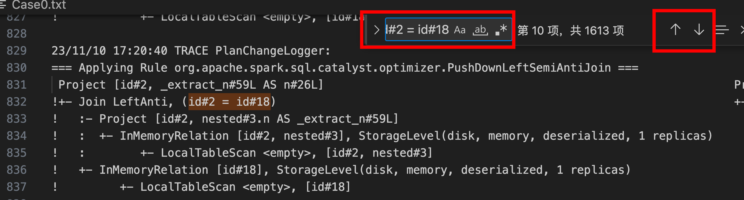
Cheating Sheet: Logs
3. Check key plans by searching:
=== Result of Batch Finish Analysis ===
1. Walk through steps by searching and jumping over === Applying Rule
Analyzed plan
(Previous plan of physical plan below)
Optimized logical plan
Adaptive execution enabled for plan
Physical plan
Final plan
2. You can do the same on predicate/attribute to trace them
Final plan

Slide 13
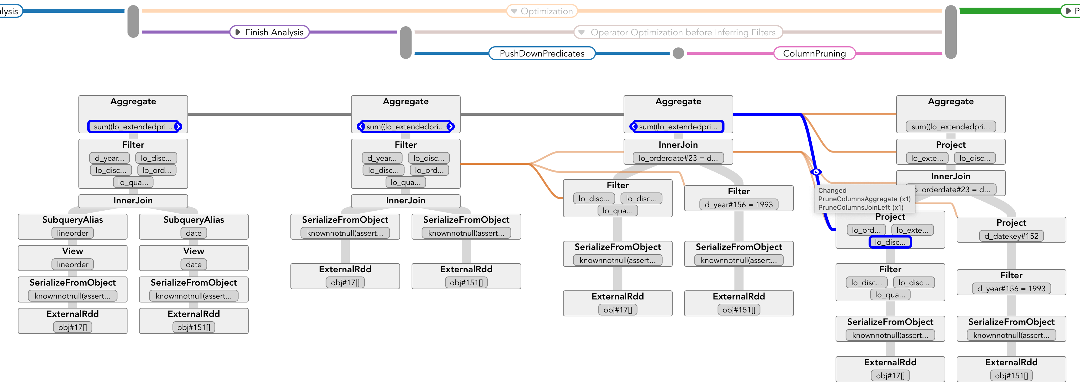
Cheating Sheet: QOVIS
Step name
or Group of
Step name
with
repeat #
Navigation view
Plan view
Unresolved plan
Final AQE plan
Analyzed plan
Physical plan
Optimized logical plan
Hover on items to see the content
Click to move to next/previous change point
Hover on links to see the transformation reason
Click param items / links to highlight and trace

